Slide 1


SRS Presentation
Adham Mohamed
Mark Ghattas
Abonoub Kaiser
Oussama Jablaoui

Slide 2
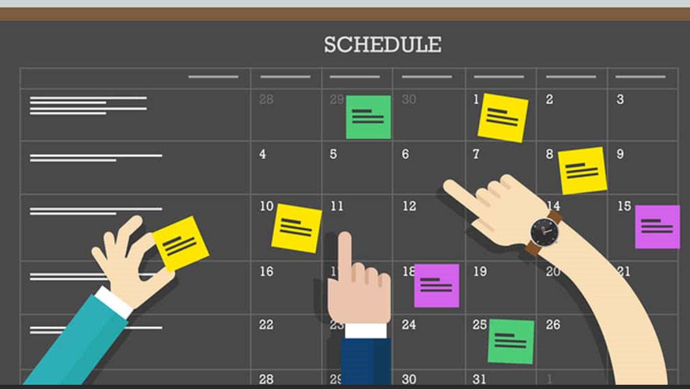

MIU Scheduler Introduction
Scheduling of the students for each entry was a redundant manual process using excel spreadsheet
This problem was addressed by initiating an automated scheduler tool that generated the schedule for a student and the professor based on their preferences and other factors.

Slide 3
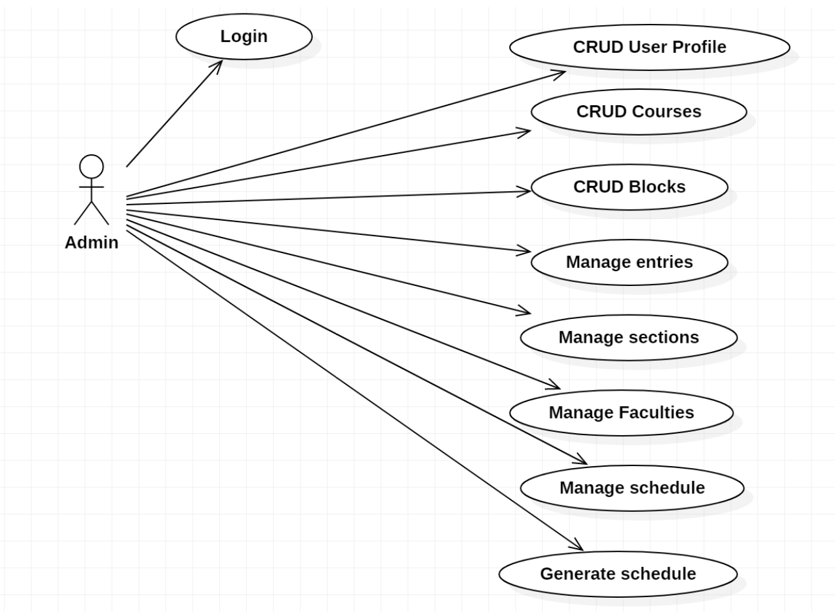
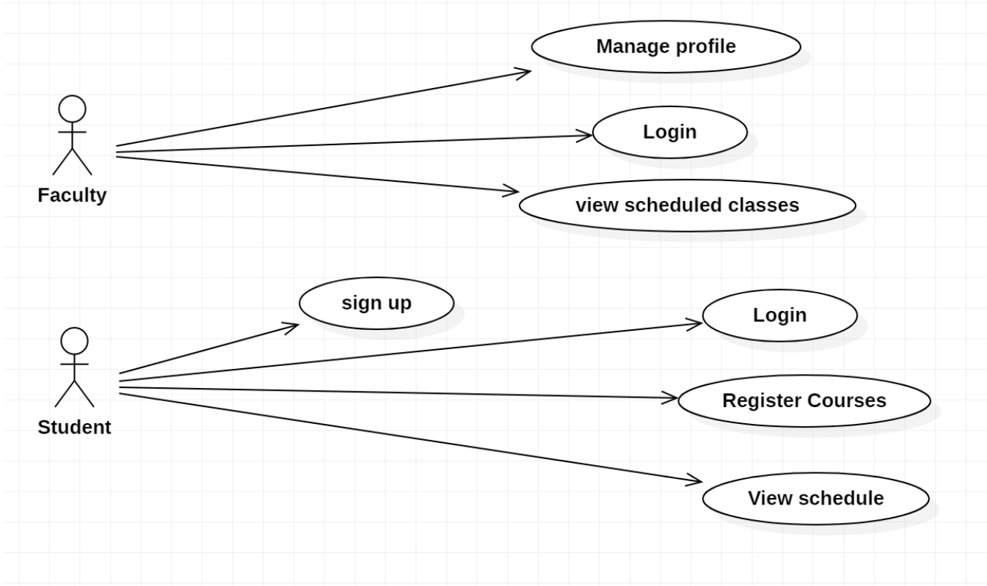
Use Case Diagrams

Slide 4
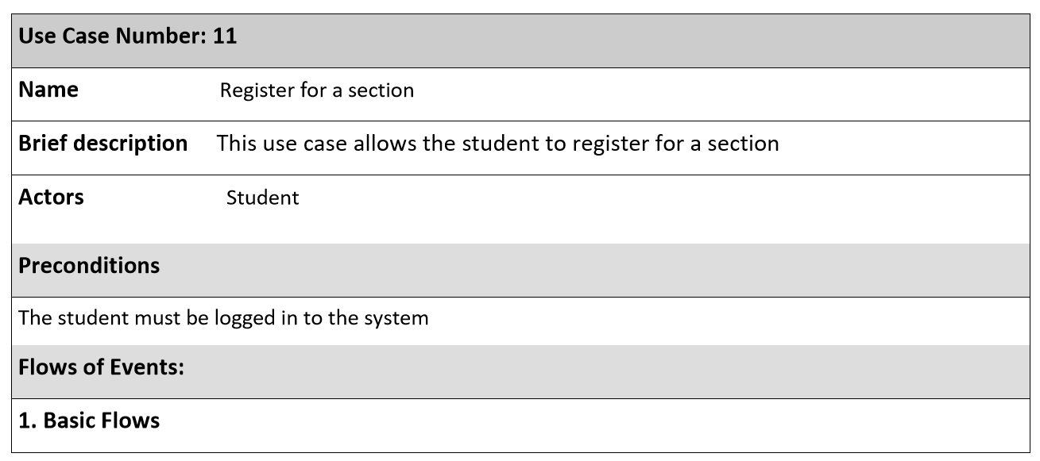
Use Case Description

Slide 5
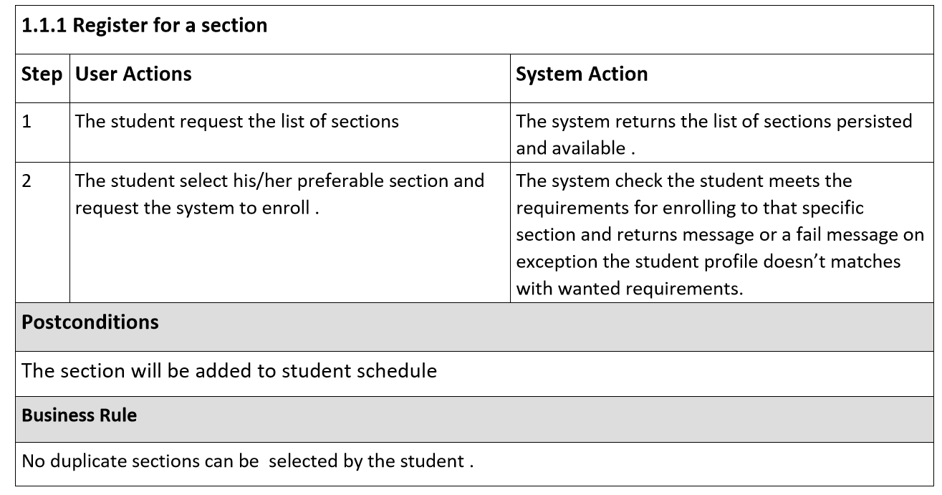
Use Case Description

Slide 6
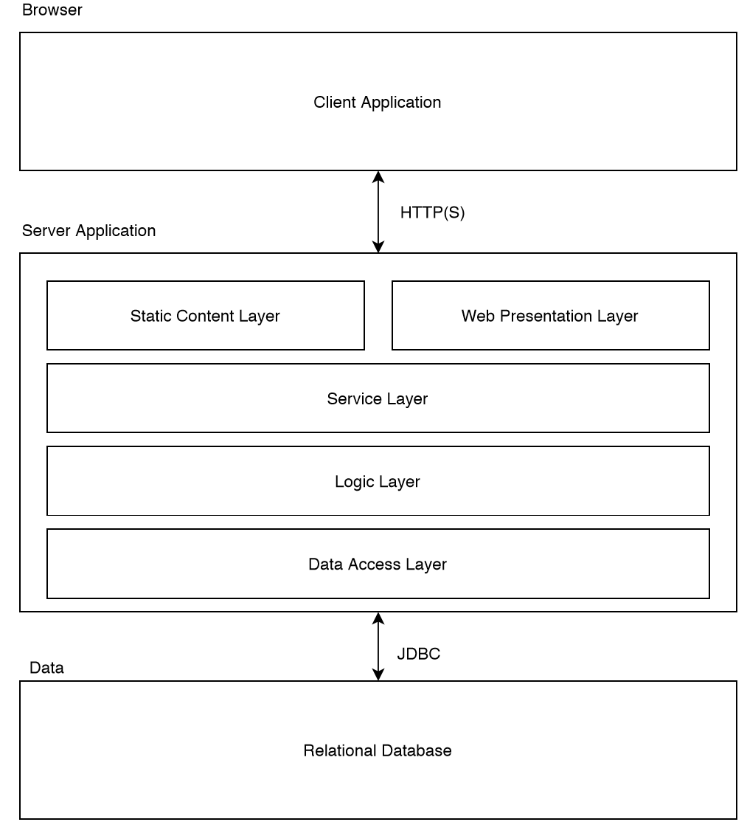


System Architecture

Slide 7
Key Abstractions
Student
Course
Block
Faculty
Section
Transcript

Slide 8
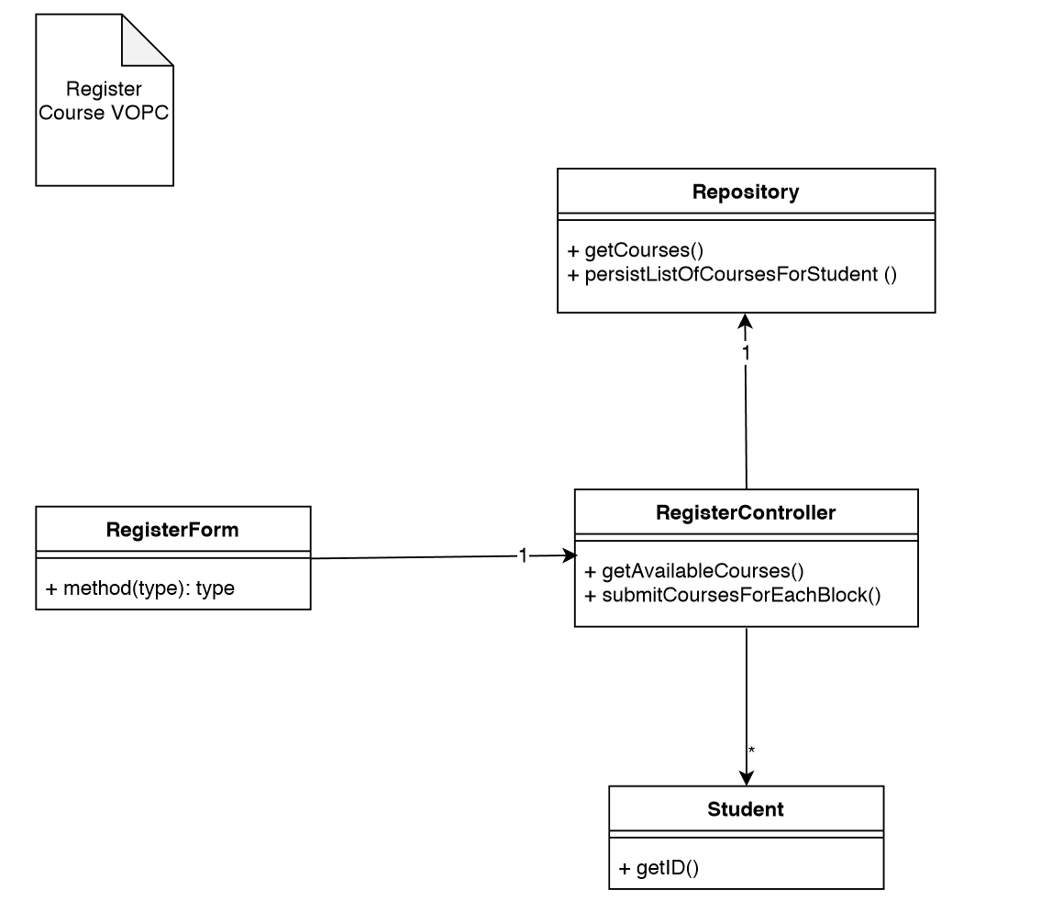
VOPC Diagram Register Course

Slide 9
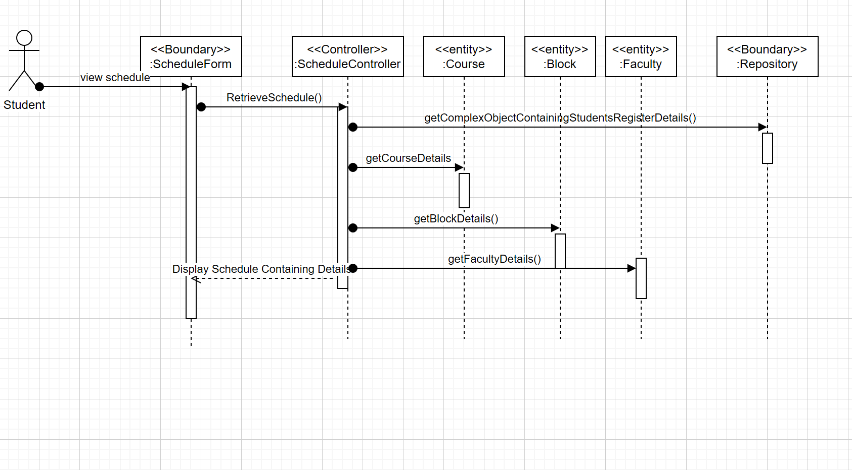
Sequence Diagram

Slide 10

Thank you Merci شكرا ☺

